Slide 1

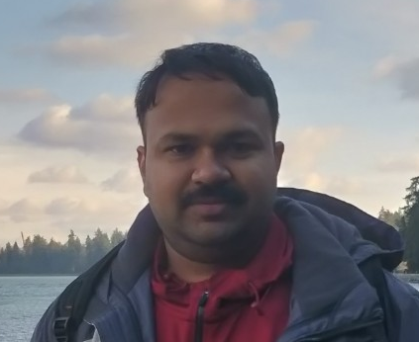
WHY TO OPTIMIZE DEEP LEARNING MODELS?
Anush Sankaran
Senior Research Scientist
Microsoft

Slide 2


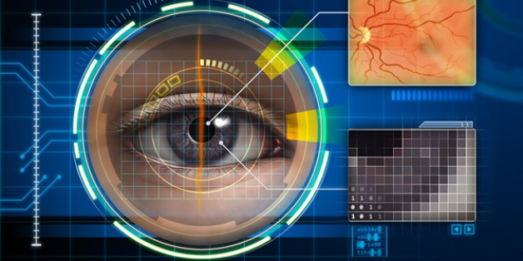




WHY DEEP LEARNING?
NLU
Computer Vision
HealthCare
Finance
Security
Education

Slide 3
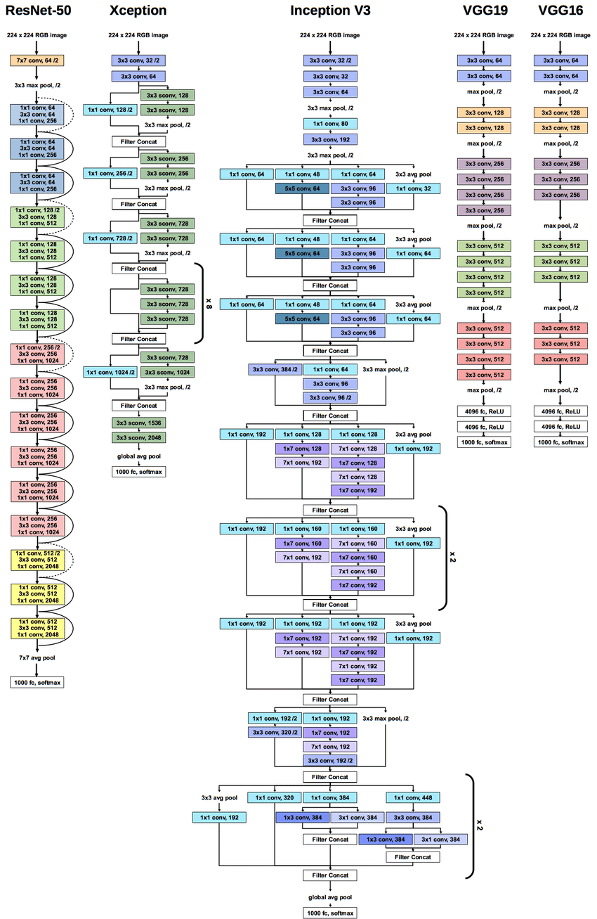
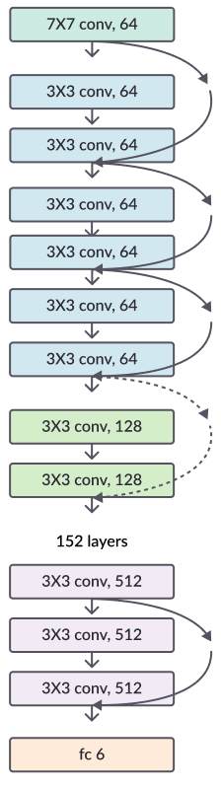
REVOLUTION OF DEPTH
VGG19
72.3%
76.6MB
19 layers
InceptionV3
74.8%
23.9MB
22 layers
ResNet18
76.8%
42.8MB
18 layers
ResNet152
78.2%
229.6MB
152 layers
2012
2014
2015
2015

Slide 4
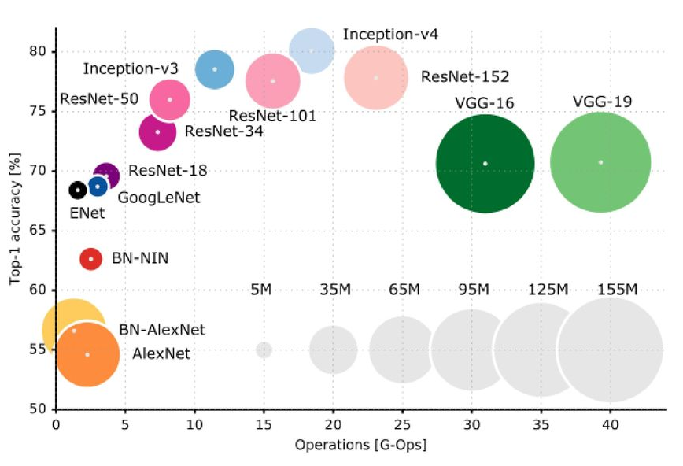
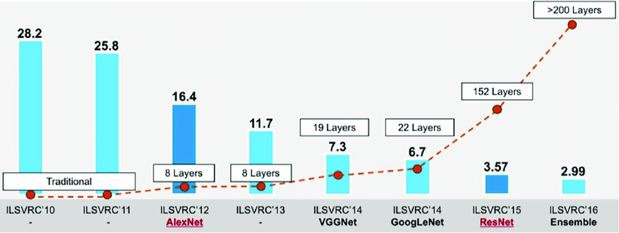
REVOLUTION OF DEPTH
More number of layers and Large size of models, results in higher accuracy!

Slide 5


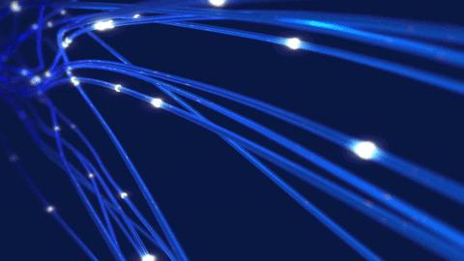


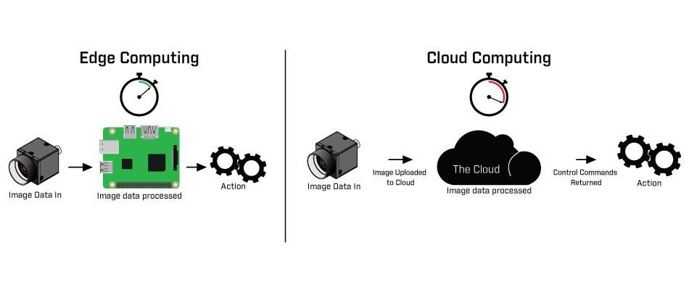
DEEP LEARNING MODEL IN PRODUCTION
End
point
Data
Cloud
Feature Extraction
Model Classification
Decision
Latency

Slide 6
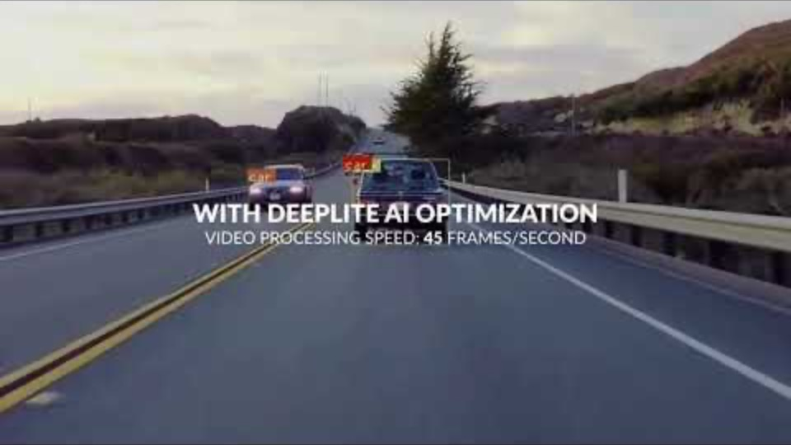
DEEP LEARNING MODEL IN PRODUCTION

Slide 7
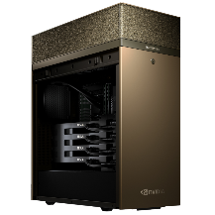
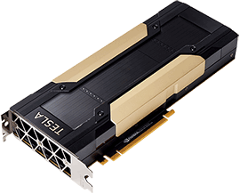
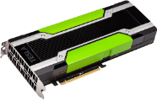

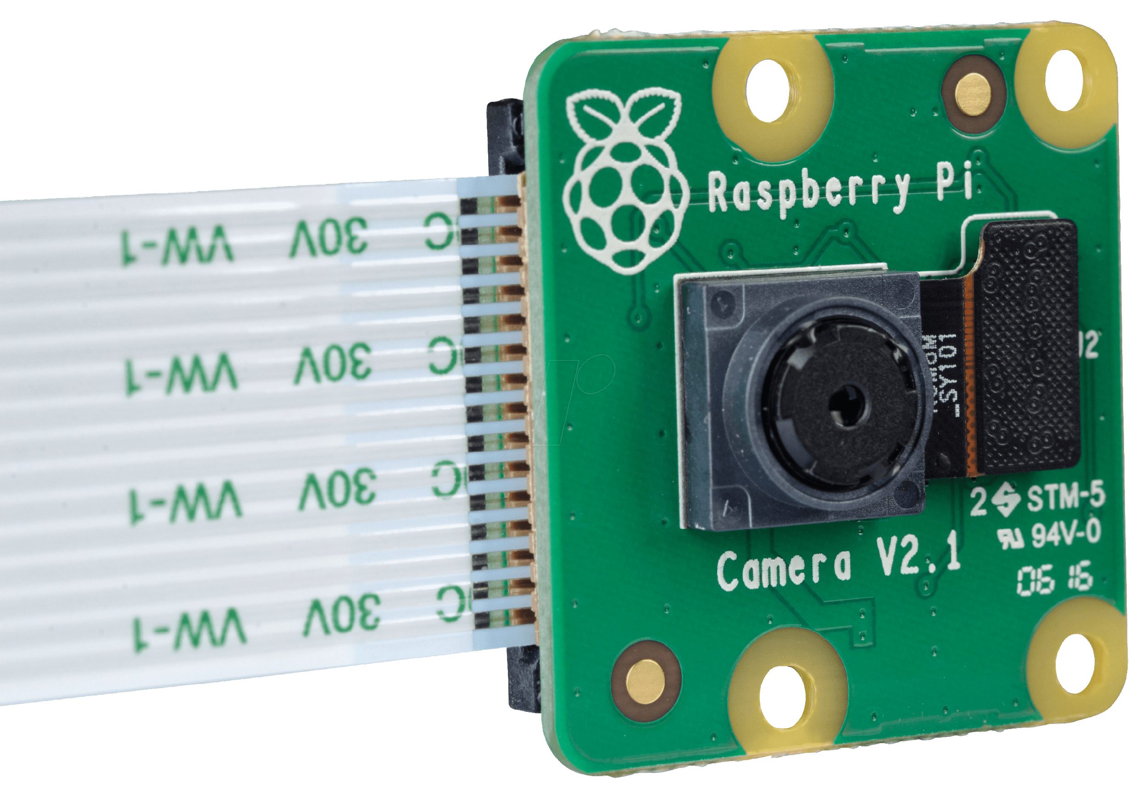
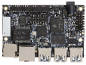
WHAT WE NEED TO ACHIEVE IN PRODUCTION
Go from here
To here
Optimized Cloud Inference
Throughput (samples/sec) | 1.5-5.0x Faster
Cloud Inference HW
Throughput (samples/sec) | 1.0x
Power Consumption | >~300w
Cost (ASP) | > $5,000
Acceleration
Edge/IoT Inference
Power Consumption | ~<10w
Cost (ASP) | ~$10
Compression

Slide 8


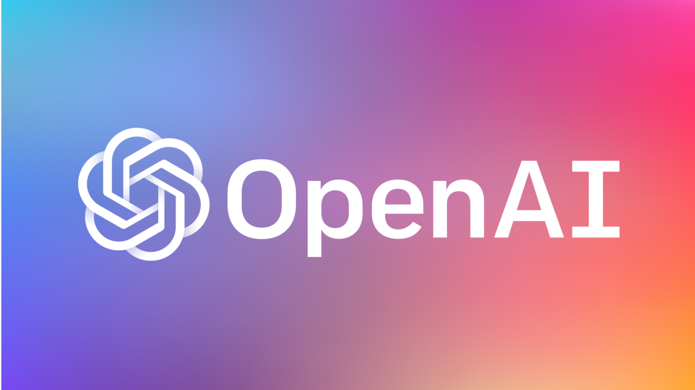
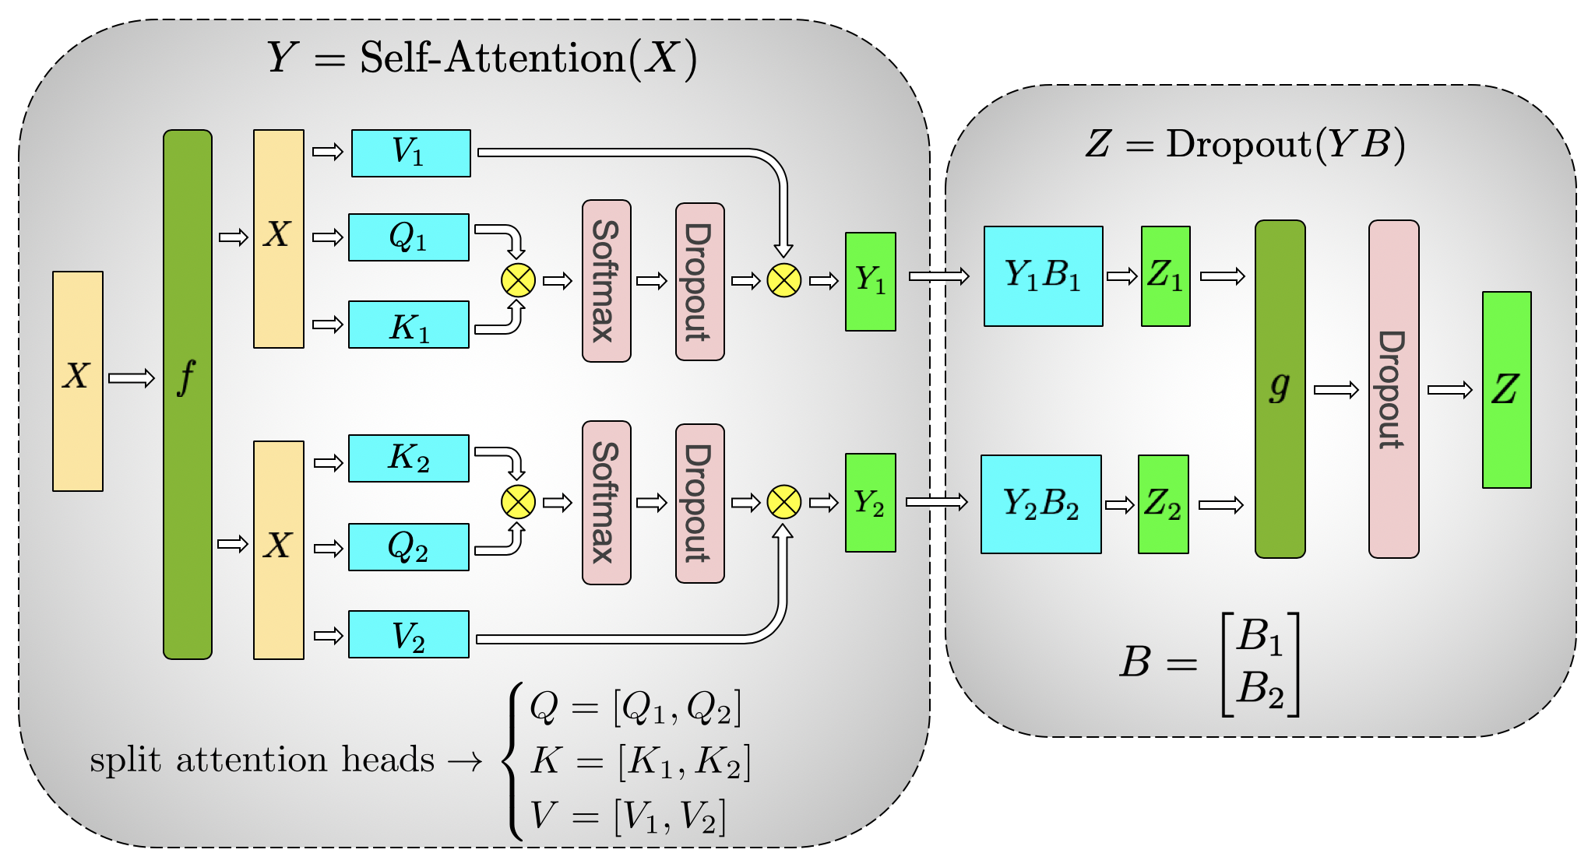
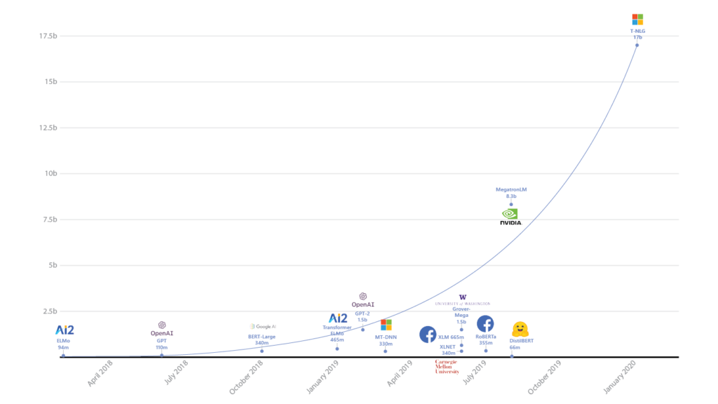
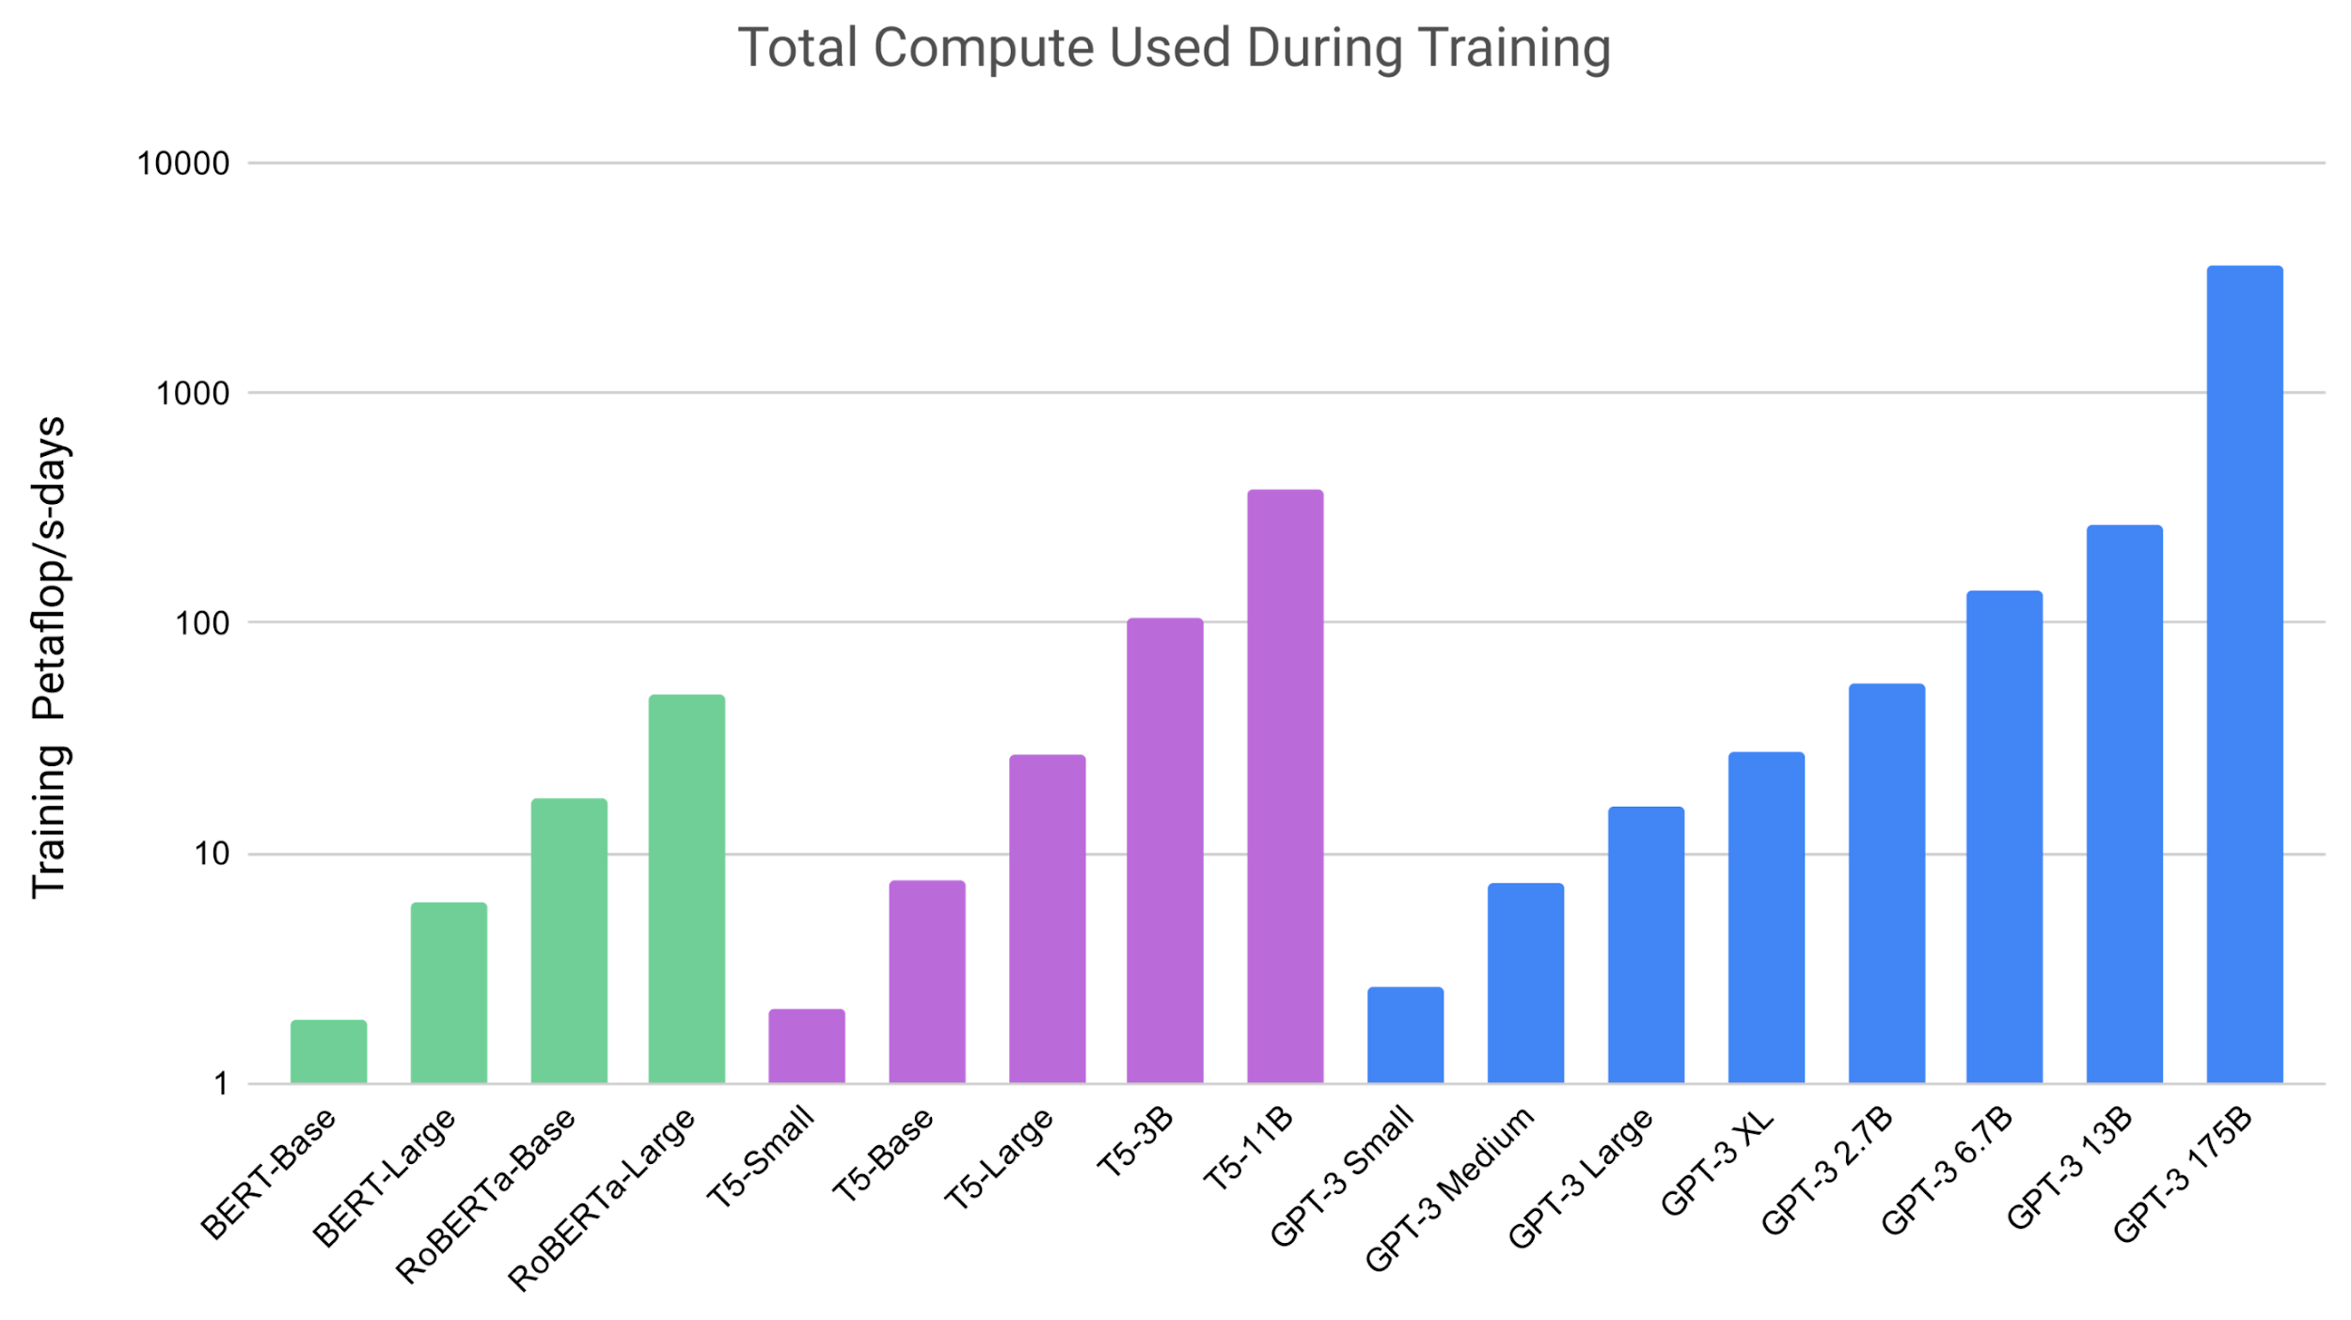
CHALLENGE #1: DEMOCRATIZATION OF DEEP LEARNING
8.3 Billion Parameters
17 Billion Parameters
175 Billion Parameters
350GB in Size
$12Million to Train
Need for extensive supercomputing capabilities to train DL models. Not everyone can afford!

Slide 9
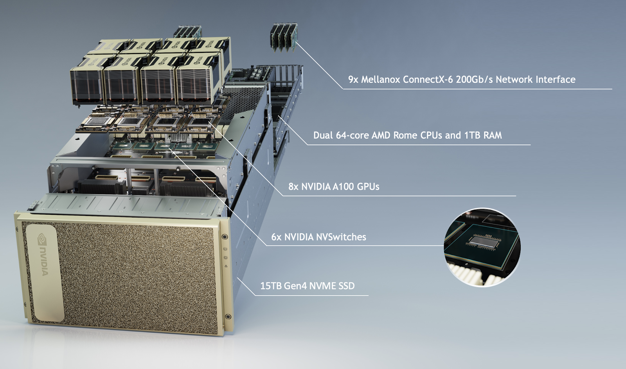
FIRST AI SUPERCOMPUTER: NVIDIA DGX A100
IIT Jodhpur Receives First 'NVIDIA DGX A100' AI Supercomputers In India
https://www.ndtv.com/education/iit-jodhpur-receives-first-nvidia-dgx-a100-ai-supercomputers-in-india

Slide 10

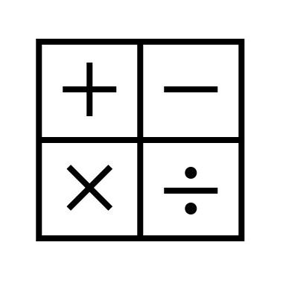




CHALLENGE #2: MULTIPLE METRICS TO OPTIMIZE
Parameters
FLOPS
Size
Trained Model
Optimized Model
Optimization of Deep Learning Model
TrainTime
InferenceTime
Energy
How to optimize based on a few selected target metrics ?

Slide 11




CHALLENGE #3: MULTIPLE HARDWARE SUPPORT
CPU
Trained Model
Optimized Model
GPU
Optimization of Deep Learning Model
Mobile
Devices
Micro Processor
How to optimize based on the target hardware to be deployed?

Slide 12


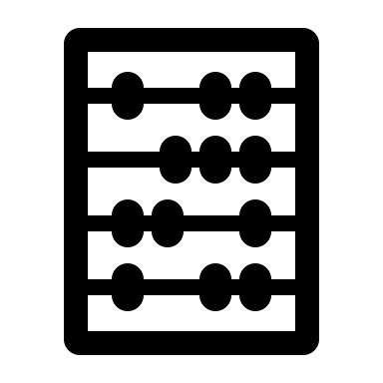

CHALLENGE #4: BLACKBOX FRAMEWORK
Lots of Manual Labor!
Trained Model
Optimized Model
Optimization of Deep Learning Model
Reusable Blackbox Framework

Slide 13
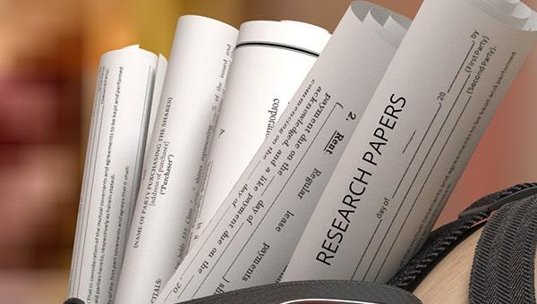
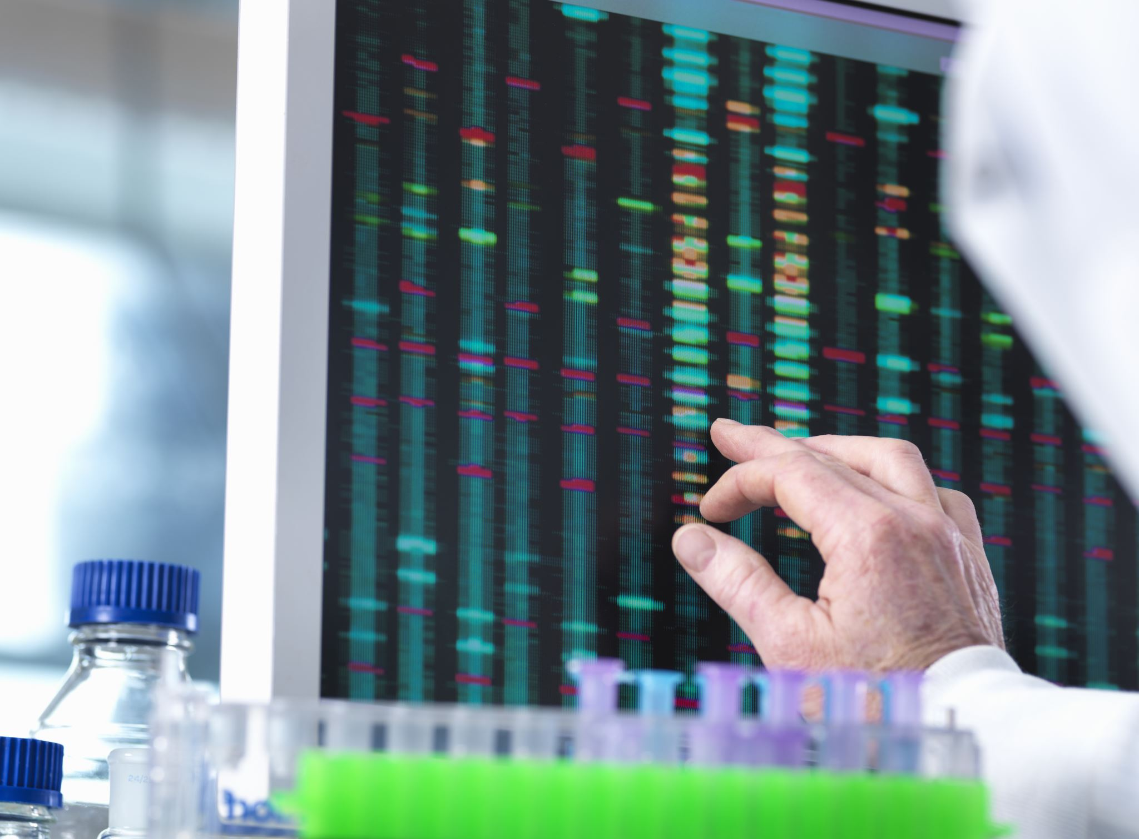
CHALLENGE #5: RESEARCH PAPERS TO PRODUCTION
Techniques overfitted for Popular models &
Benchmark datasets
Optimization of Deep Learning Model
How to develop generalizable solutions across any kind of model and dataset?

Slide 14
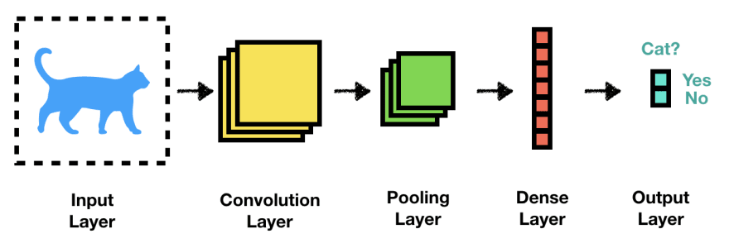
COST OF ADDING ONE LAYER
Total number of parameters: = (3 * 3 * 256 * 512) * 4 bytes
= 4.5 MB
Total size of activations:
= (128 * 224 * 224 * 512) * 4 bytes
= 12.25 GB
Total size of gradients:
= (128 * 224 * 224 * 512) * 4 bytes
= 12.25 GB
Total size of the layer:
= 4.5 MB + 12.25 GB + 12.25GB
128 * 224 * 224 * 256
3 * 3
512
128 * 224 * 224 * 512
So, please think twice before adding a new Convolutional Layer to your Model!

Slide 15
IDEA OF OPTIMIZATION
Identify the trainable layers in the model and reduce the number of parameters!

Slide 16
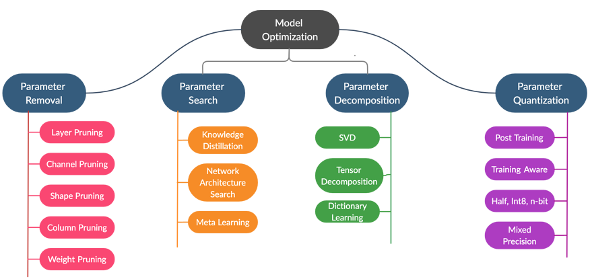
HOW DO WE OPTIMIZE DEEP LEARNING MODELS?

Slide 17
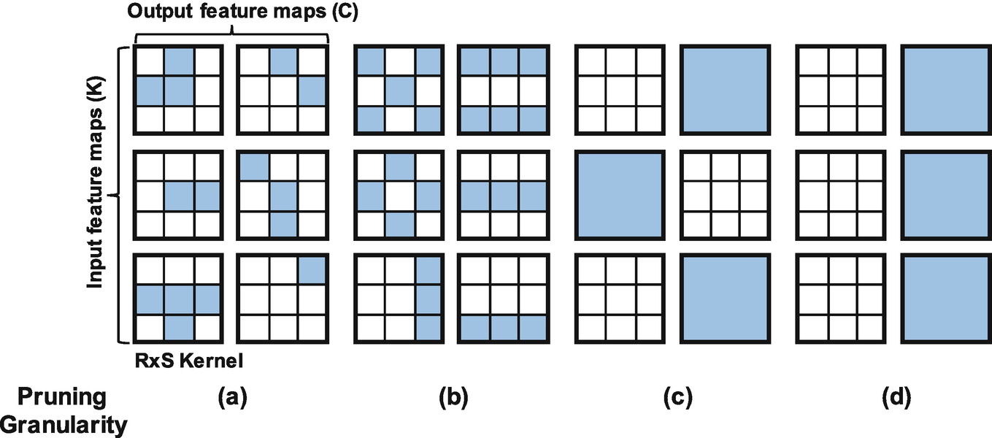
PARAMETER REMOVAL
Weight Pruning
Column Pruning/
Shape Pruning
False Pruning: Does not reduce the number of FLOPs or computations

Slide 18
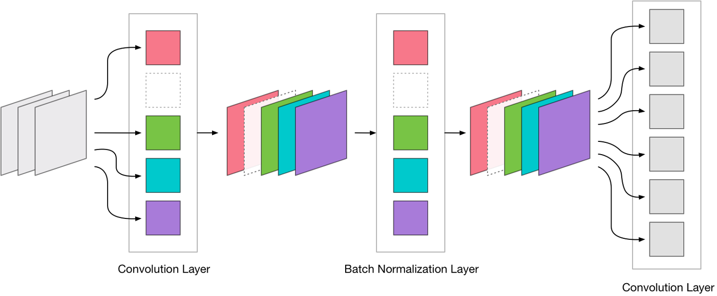
PARAMETER REMOVAL
Layer Pruning
How to identify which layer to prune without loss of accuracy?

Slide 19
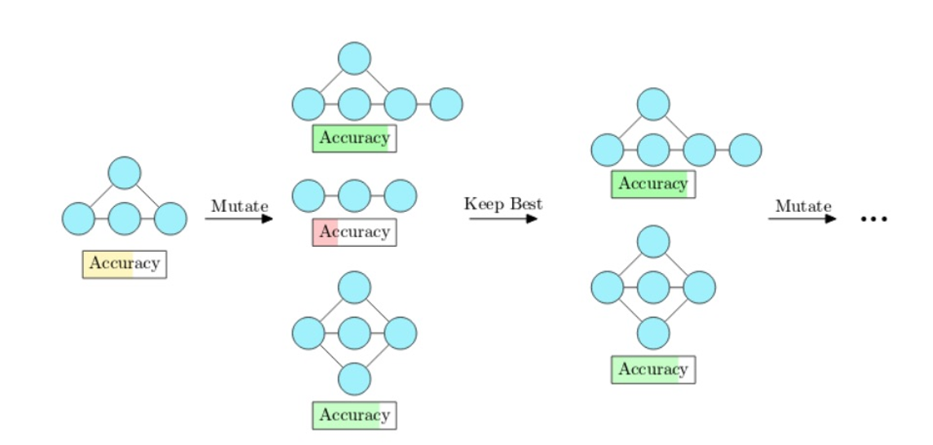
PARAMETER SEARCH

Slide 20
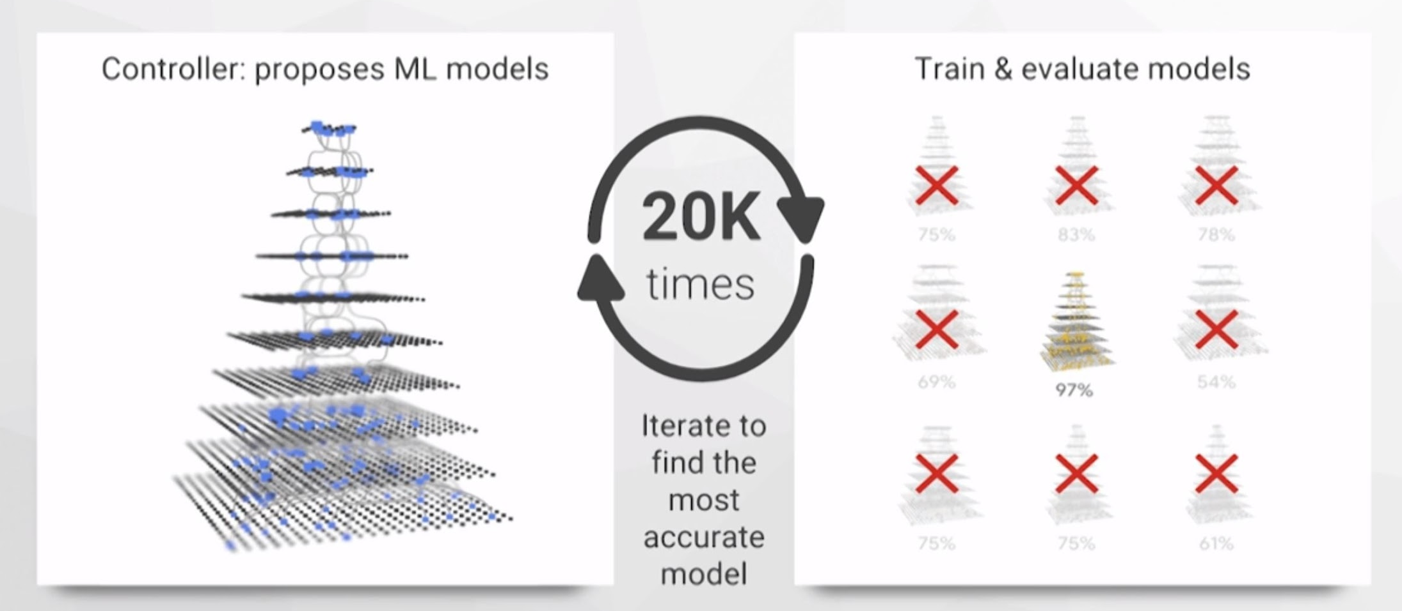
PARAMETER SEARCH
Too Costly: Every sampled new architecture have to be trained!

Slide 21
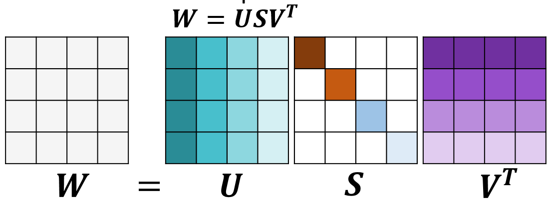
PARAMETER DECOMPOSITION
How to find the low-rank approximation of “U” and “V” ?

Slide 22
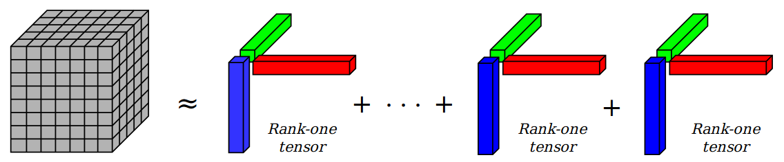
PARAMETER DECOMPOSITION
How to find the low-rank approximation n-dimensional tensors?

Slide 23
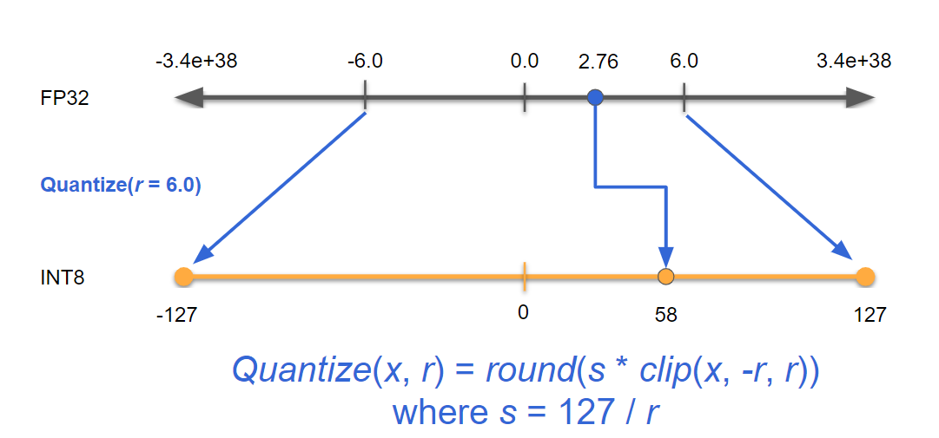
PARAMETER QUANTIZATION
Will INT8 reduce the accuracy? Will all the hardware support INT8 multiplication?

Slide 24
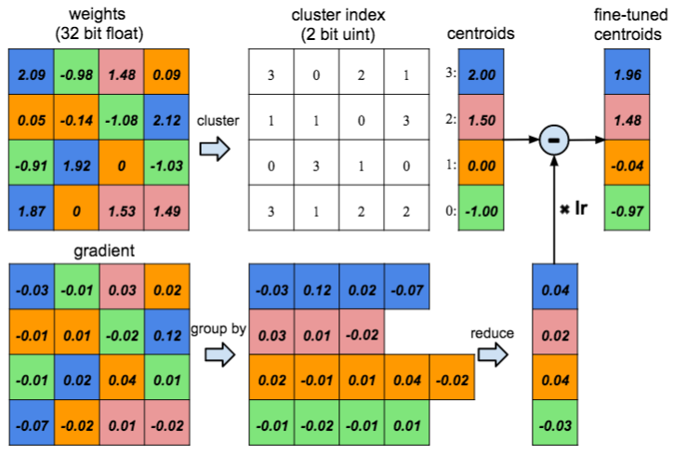
PARAMETER QUANTIZATION
Reduce 32bits to 2bits encoding, without loss of accuracy?

Slide 25



AI for everyday life.

Slide 26
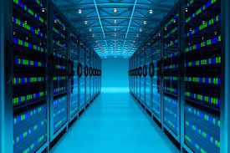
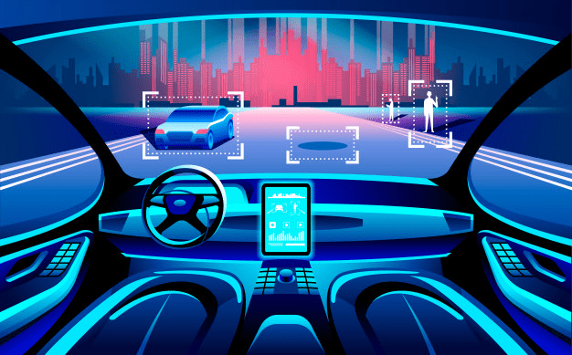
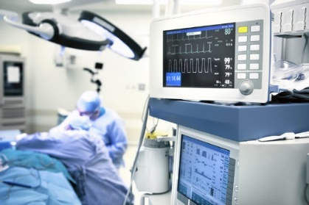
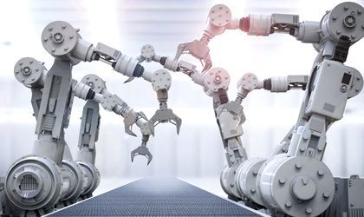
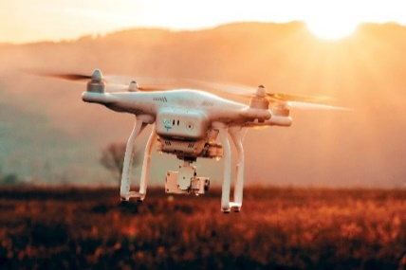
DEEPLITE: WHAT WE DO?
We use AI to make other AI
smaller, faster and more energy efficient
in the cloud and at the edge
Cloud-based Inference
Connected & Autonomous Vehicles
Life-critical Medical Devices
Robotics & Industrial Automation
Drones, IoT & Security

Slide 27









DEEPLITE: ADD OPTIMIZATION TO CURRENT PIPELINES
Feedback loop
PROD
Code
Cloud
Build/Design DNNs
Train
Test
Deploy
Edge
Data
Data preprocessing
Visualization, HP tuning
Architecture design
TensorFlow, PyTorch
TensorFlow
PyTorch, mxnet
Distributed training
Cloud/on-prem
Deeplite
Automated Optimizer
Functionality Test
Integration Test
Performance Test
Bundling
ONNX
Flask

Slide 28

DEEPLITE: BLACK-BOX OPTIMIZATION
-0.5%
Set acceptable Accuracy Level
549MB
11.9MB
Primary design KPI
Mode
Compression
Deepsearch
OPTIMIZE
✓ Compression
Speed
Power Consumption
✓ Deepsearch
Target
Your Optimized Model
Your Trained Model
Results
x46
x4
x5
-0.3%
Compression
Speed Up
Power Reduction
Accuracy Change

Slide 29
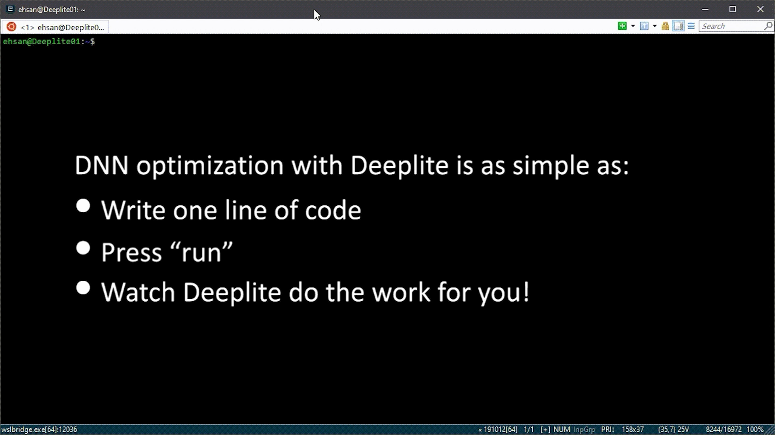
DEEPLITE: BLACK-BOX OPTIMIZATION
80MB
2.2MB
Your Optimized Model
Your Trained Model
As simple as that!

Slide 30







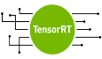

DEEPLITE: TECHNICAL STACK
DNN Models Trained for Accuracy
Deeplite Content Aware Optimizer
Deeplite Platform Aware Optimizer
Third party Compilers and Low-Level platform aware Optimization
Proprietary SDK’s
Deeplite Micro
Inference Engine
content + platform aware optimization for maximum efficiency
GPU FPGA, Intel CPU, ARM RISC-V, etc.
ASIC
CPU
AI ACCELERATORS
ARM
RISC-V
x86

Slide 31

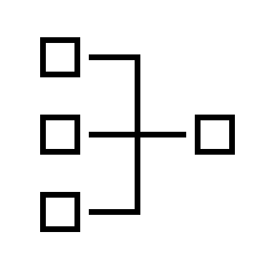





DEEPLITE: NEUTRINO ENGINE
Public Zoo
Neutrino™ Zoo
Custom Zoo
Train &
Test Data
Pretrained Model
Stage1: Coarse Exploration
Stage2: Deep Annealing
Final
Training
End-user
User Constraints
1. Accuracy delta
2. Target size
3. Num of params
...
Optimized
Model
Optimized
Model
Optimized
Model
Input Information

Slide 32
RESULTS ON POPULAR MODELS
Arch | Model | Accuracy (%) | Size (MB) | MACs (Billions) | #Params (Millions) | Memory (MB) | Execution Time (ms)
Resnet 18 | Original | 76.8295 | 42.8014 | 0.5567 | 11.2201 | 48.4389 | 0.0594
 | Stage 1 | 76.7871 | 7.5261 | 0.1824 | 1.9729 | 15.3928 | 0.0494
 | Stage 2 | 75.8008 | 3.4695 | 0.0790 | 0.9095 | 10.3965 | 0.0376
 | Enhance | -0.9300x | 12.34x | 7.05x | 12.34x | 4.66x | 1.58x
Resnet50 | Original | 78.0657 | 90.4284 | 1.3049 | 23.7053 | 123.5033 | 3.9926
 | Stage 1 | 78.7402 | 25.5877 | 0.6852 | 6.7077 | 65.2365 | 0.2444
 | Stage 2 | 77.1680 | 8.4982 | 0.2067 | 2.2278 | 43.7232 | 0.1772
 | Enhance | -0.9400 | 10.64x | 6.31x | 10.64x | 2.82x | 1.49x
VGG19 | Original | 72.3794 | 76.6246 | 0.3995 | 20.0867 | 80.2270 | 1.4238
 | Stage 1 | 71.5918 | 3.3216 | 0.0631 | 0.8707 | 7.5440 | 0.0278
 | Stage 2 | 71.6602 | 2.6226 | 0.0479 | 0.6875 | 6.7399 | 0.0263
 | Enhance | -0.8300 | 29.22x | 8.34x | 29.22x | 11.90x | 1.67x

Slide 33
RESULTS ON POPULAR MODELS
Arch | Model | Accuracy (%) | Size (MB) | MACs (Billions) | #Params (Millions) | Memory (MB) | Execution Time (ms)
DenseNet121 | Original | 78.4612 | 26.8881 | 0.8982 | 7.0485 | 66.1506 | 10.7240
 | Stage 1 | 79.0348 | 15.7624 | 0.5477 | 4.132 | 61.8052 | 0.2814
 | Stage 2 | 77.8085 | 6.4246 | 0.1917 | 1.6842 | 48.3280 | 0.2372
 | Enhance | -0.6500 | 4.19x | 4.69x | 4.19x | 1.37x | 1.17x
GoogleNet | Original | 79.3513 | 23.8743 | 1.5341 | 6.2585 | 64.5977 | 5.7186
 | Stage 1 | 79.4922 | 12.6389 | 0.8606 | 3.3132 | 62.1568 | 0.2856
 | Stage 2 | 78.8086 | 6.1083 | 0.3860 | 1.6013 | 51.3652 | 0.2188
 | Enhance | -0.4900 | 3.91x | 3.97x | 3.91x | 1.26x | 1.28x
MobileNet v1 | Original | 66.8414 | 12.6246 | 0.0473 | 3.3095 | 16.6215 | 1.8147
 | Stage 1 | 66.4355 | 6.4211 | 0.0286 | 1.6833 | 10.5500 | 0.0306
 | Stage 2 | 66.6211 | 3.2878 | 0.0170 | 0.8619 | 7.3447 | 0.0286
 | Enhance | -0.4000 | 3.84x | 2.78x | 3.84x | 2.26x | 1.13x

Slide 34
RESULTS ON LARGE SCALE DATASETS (RESNET18)
Arch | Model | Accuracy (%) | Size (MB) | MACs (Billions) | #Params (Millions) | Memory (MB) | Execution Time (ms)
Imagenet16 | Original | 94.4970 | 42.6663 | 1.8217 | 11.1847 | 74.6332 | 0.2158
 | Stage 1 | 93.8179 | 3.3724 | 0.5155 | 0.8840 | 41.0819 | 0.1606
 | Stage 2 | 93.6220 | 1.8220 | 0.3206 | 0.4776 | 37.4608 | 0.1341
 | Enhance | -0.8800 | 23.42x | 5.68x | 23.42x | 1.99x | 1.61x
VWW (Visual Wake Words) | Original | 93.5995 | 42.6389 | 1.8217 | 11.1775 | 74.6057 | 0.2149
 | Stage 1 | 93.8179 | 3.3524 | 0.4014 | 0.8788 | 39.8382 | 0.1445
 | Stage 2 | 92.6220 | 1.8309 | 0.2672 | 0.4800 | 36.6682 | 0.1296
 | Enhance | -0.9800 | 23.29x | 6.82x | 23.29x | 2.03x | 1.66x

Slide 35
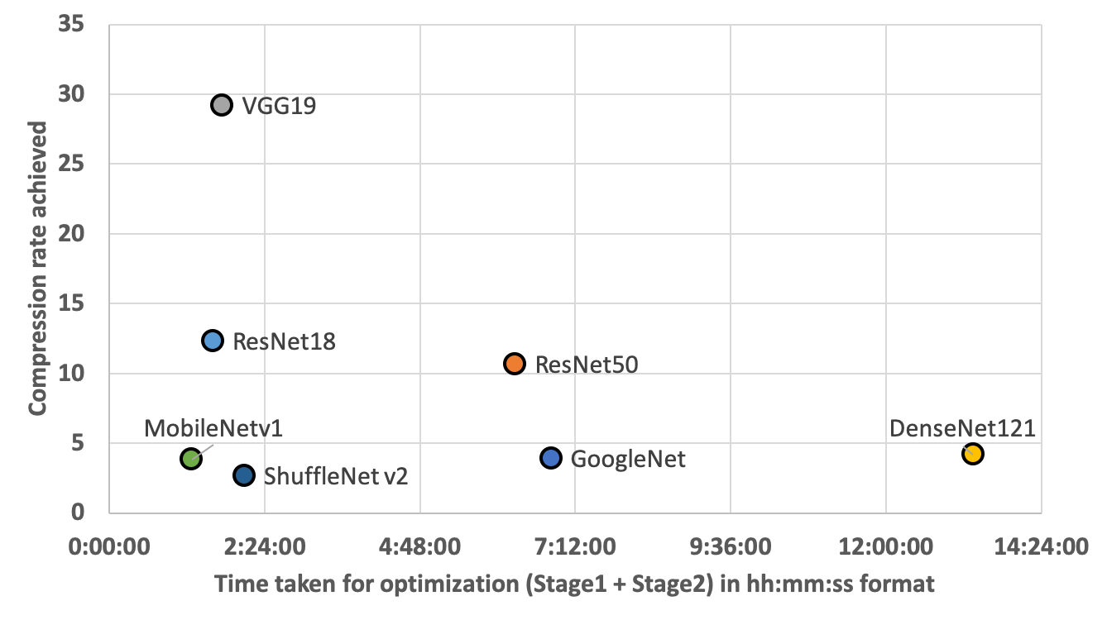
TIME TAKE FOR OPTIMIZATION

Slide 36
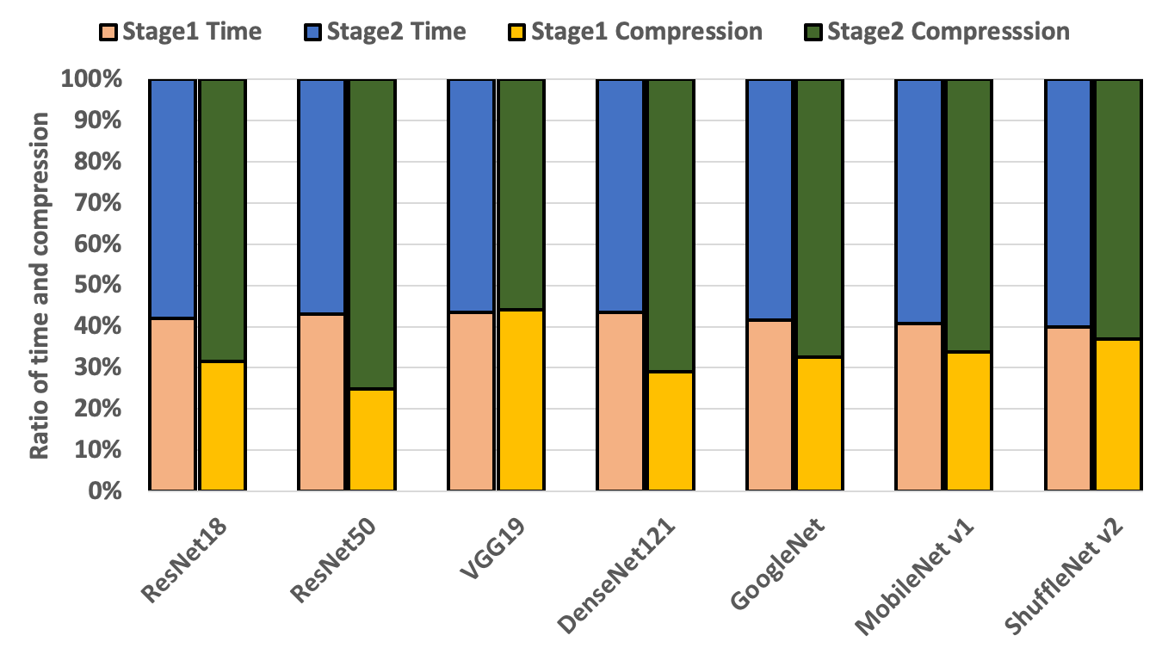
STAGE 1 VS. STAGE 2

Slide 37
DEEP LEARNING MODEL IN PRODUCTION

Slide 38
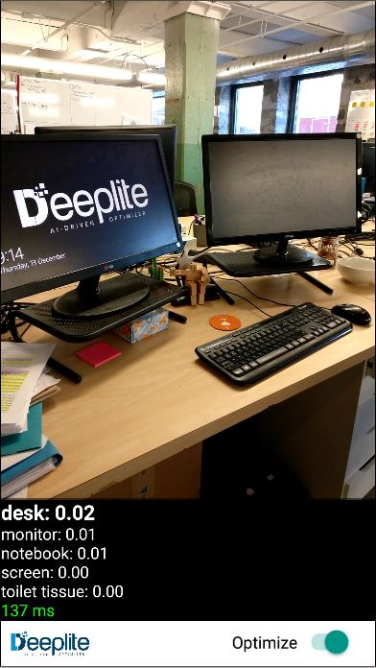
DEEP LEARNING MODEL IN PRODUCTION
10x speedup on ARM mobile CPU
Optimized vs. Unoptimized model on Android phone

Slide 39
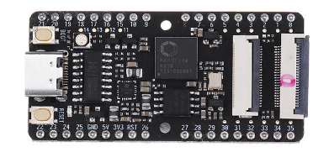
INDUSTRY USE CASE #1
Embedded solution where a home assistant “wakes up” when it detects a person via a small camera (link to press release)
Original Model:
Mobilenet-v1.0 (12.8MB)
Platform:
Andes RISC-V CPU cores
Requirements:
Size < 256KB
Accuracy drop < 2.0%
Deeplite Results:
Size = 188KB (69 times smaller)
Accuracy drop ~ 1.0%
Cost: $40
Power: 3w

Slide 40
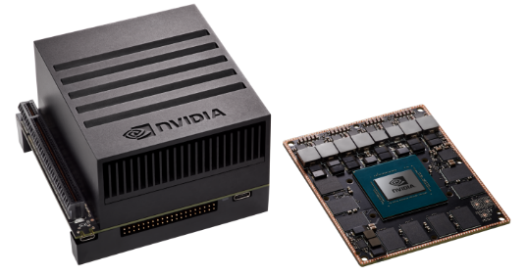
INDUSTRY USE CASE #2
Optimize SSD300 object detection model with ResNet-50 backbone for autonomous vehicle deployment
Original Model:
SSD300 (56.7MB)
Platform:
NVIDIA Xavier GPU
Requirements:
Accuracy drop < 1.0%
Deeplite Results:
Size = 4.8MB (12 times smaller)
Power reduction ~ 3x
Speed up ~ 3x
Accuracy drop ~ 0%
Cost: $700
Power: 10-30w

Slide 41
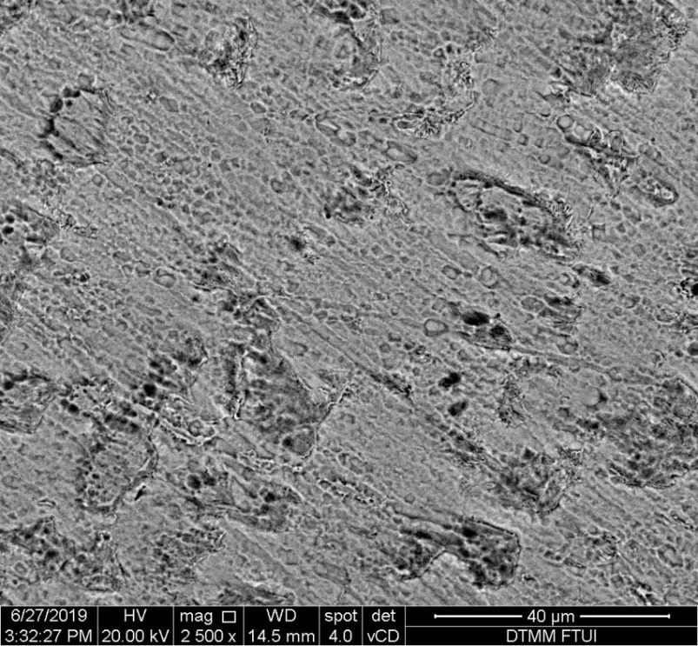

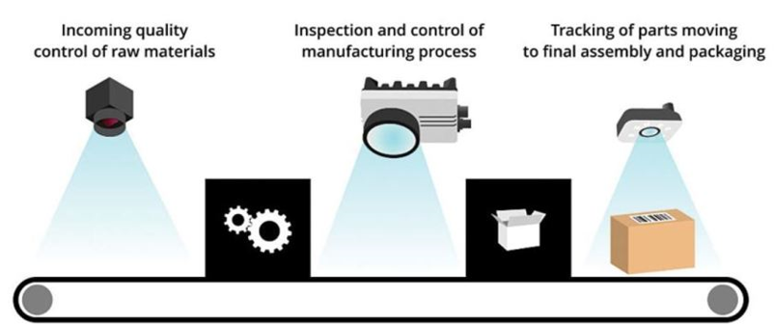
INDUSTRY USE CASE #3
Smart Manufacturing Computer Vision use case
ARM Cortex-M4 (256KB of on chip memory, 1MB of flash)
MobileNetv1 CNN trained on proprietary binary classification dataset
Target optimization metrics are model size (in MB) and accuracy
acceptable
unacceptable
Model | Size (bytes) | GMac | Parameters (millions) | Accuracy
Initial | 12836104B | 0.583 | 3.21 | Top1:92.443%
Optimized | 144186B (89.04x) | 0.112 (5.21X) | 0.14 (22.26X) | Top1:90.607% (-1.84%)

Slide 42
THANK YOU!
FOR MORE INFORMATION ABOUT DEEPLITE PLEASE CONTACT:
CHARLES MARSH, CCO, CHARLES@DEEPLITE.AI
DAVIS SAWYER, CPO, DAVIS@DEEPLITE.AI

